Slide 1

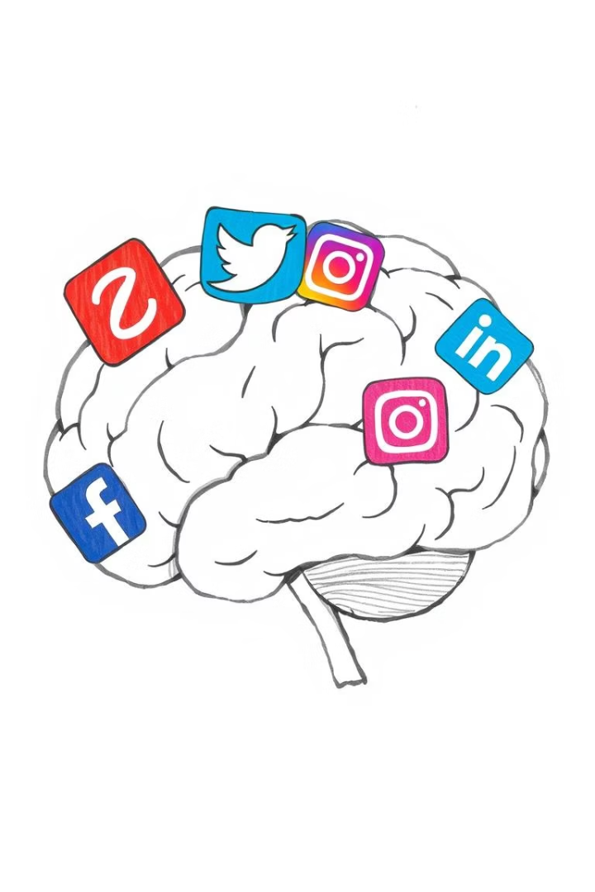
Introduction to AI (AI101B)
Session (2024-25)
Satyjeet Kumar 202410116100187
Saurabh Kumar 202410116100188
Priyam Sharma 202410116100152
Mental Health Prediction on Social Media
Leveraging Data Science for Early Detection and Awareness

Slide 2
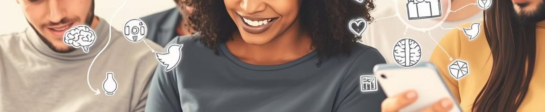
Introduction: The Growing Mental Health Crisis
Global Impact
Social Media as a Window
Opportunities for Intervention
Mental health disorders affect one in eight people worldwide, as reported by the WHO. The prevalence is rising steadily, indicating an urgent public health issue.
With 4.9 billion users in 2024, social platforms reflect individual thoughts, feelings, and behaviors, presenting valuable data for mental health insights.
The rise in anxiety and depression since 2020 underscores the need for innovative ways to detect and support individuals early through online signals.

Slide 3
Problem Statement: Untreated Mental Illness
Resource Limitations
Stigma and Underreporting
Missed Social Signals
Many individuals lack access to affordable and timely mental health care, creating delays in diagnosis and treatment that worsen outcomes.
Only 47.2% of U.S. adults with mental illness received treatment in 2021 due to societal stigma and reluctance in seeking help.
Indicators of mental distress often appear in social media posts but remain unnoticed or unaddressed by traditional healthcare systems.

Slide 4
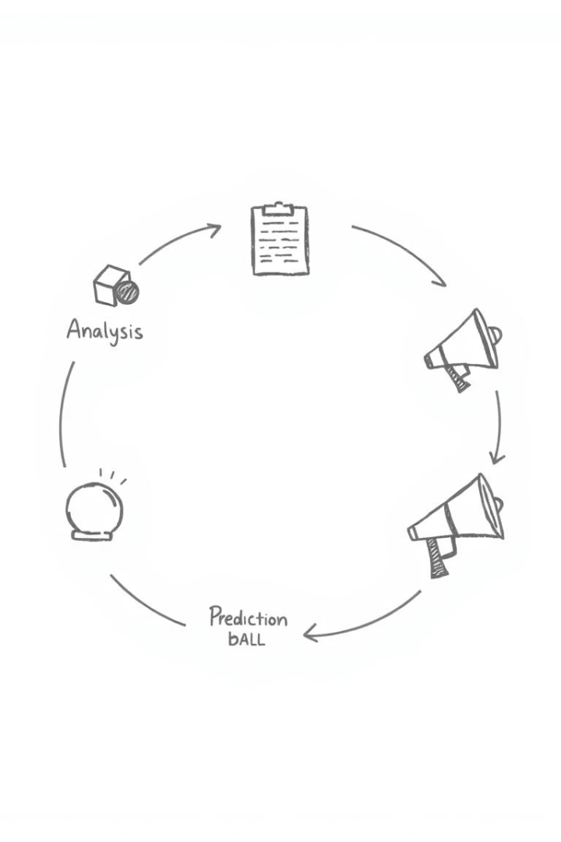




Objectives: Proactive Mental Health Support
Early Risk Detection
Build systems that identify potential mental health risks early based on social media data patterns.
Awareness & Stigma Reduction
Use data insights to inform public campaigns that normalize treatment and encourage help-seeking behaviors.
Timely Support
Facilitate connections between individuals showing risk signs and available mental health resources promptly.
Optimize Care Services
Enhance mental health service efficiency through predictive analytics and resource allocation.

Slide 5
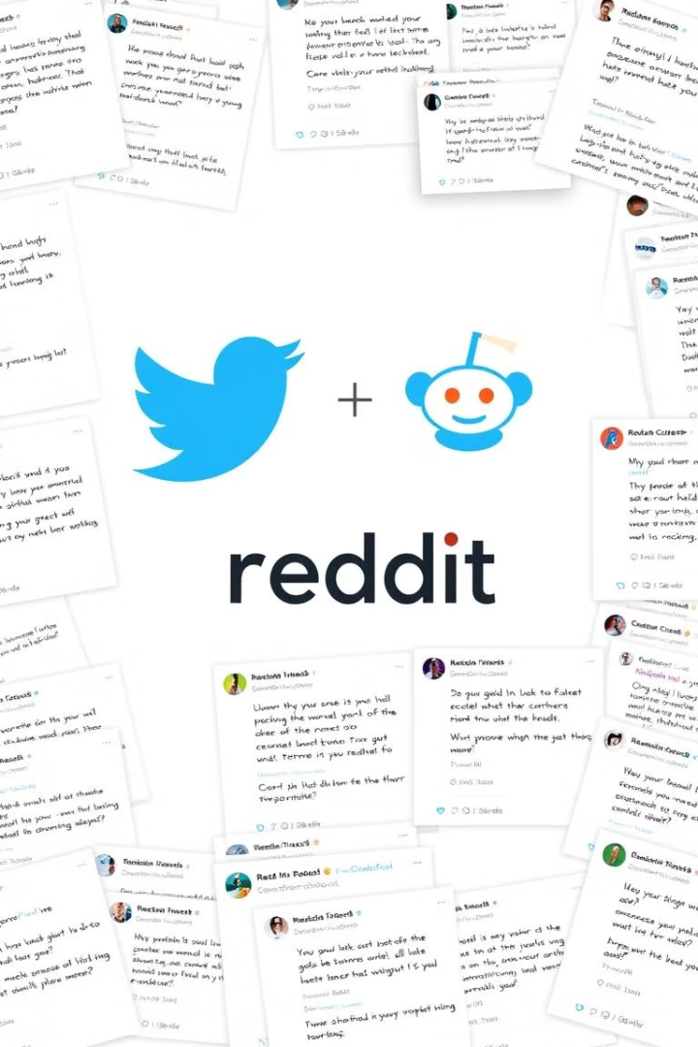



Data Sources: Mining Social Insights
Twitter
Reddit
Privacy & Ethics
Analyzing public tweets and hashtags for linguistic cues, behavior trends, and emotional expressions related to anxiety and depression.
Mining mental health subreddits like r/depression for sentiment and topical discussions, offering rich textual and contextual data.
Ensuring ethical data collection respecting user privacy, consent, and compliance with legal frameworks such as GDPR.

Slide 6

Techniques: Machine Learning and NLP
Natural Language Processing
Machine Learning Models
Sentiment Analysis Accuracy
Employing sentiment analysis, topic modeling, and emotion detection with tools like NLTK, spaCy, and BERT transformers to decode textual data.
Using classification algorithms such as SVM and Random Forest, as well as deep learning methods like LSTMs to predict mental health risks from patterns.
Benchmark methods like VADER provide 80-85% accuracy, contributing to reliable sentiment scoring in social media content.
sentiment_score = positive_words - negative_words

Slide 7
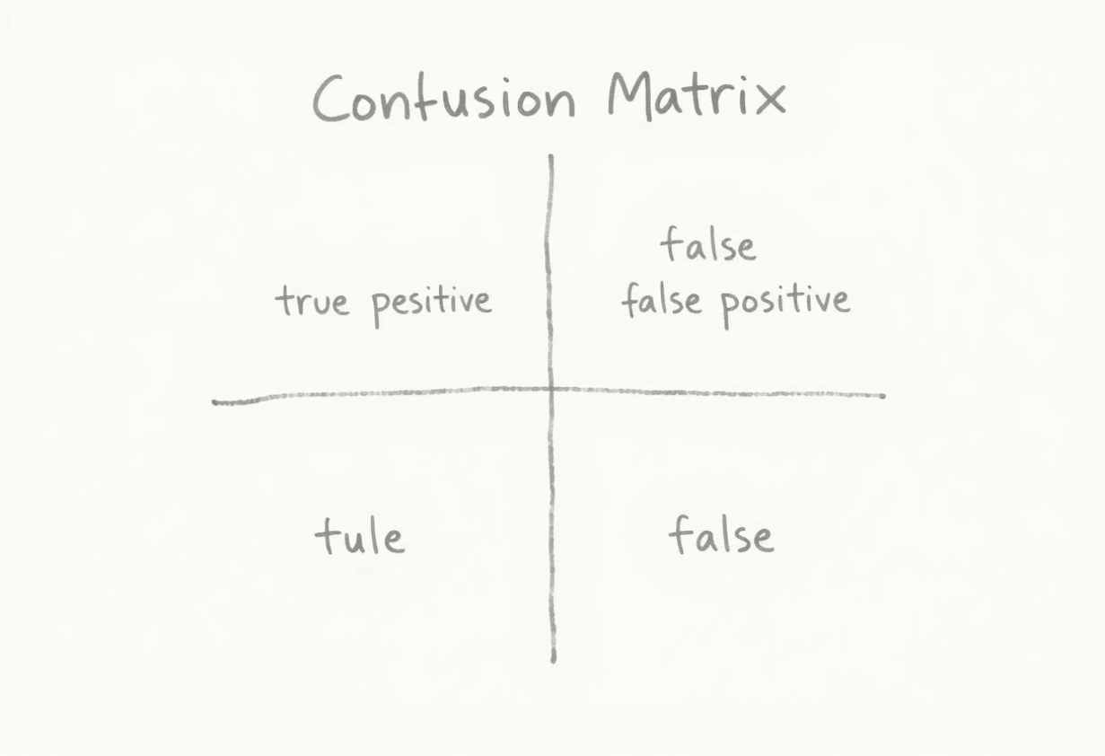
Workflow: From Data to Prediction
Data Steps
Model & Evaluation
Collect raw social media text data
Train predictive models on labeled datasets
Preprocess: clean, tokenize, remove noise
Evaluate using precision, recall, and F1-score metrics
Extract meaningful features (e.g., keywords, sentiments)
Generate predictions for mental health risk assessment

Slide 8
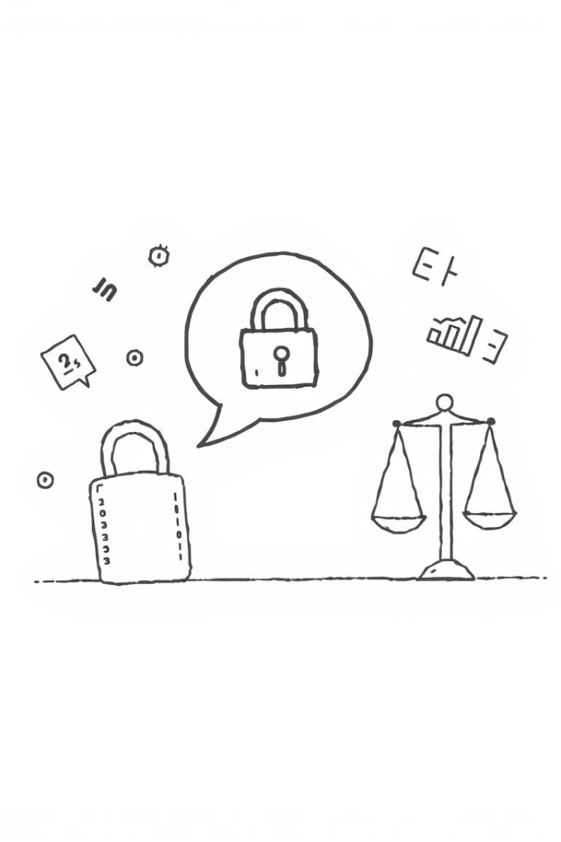
Challenges: Privacy, Sarcasm, and Bias
Privacy Concerns
Protecting individual data rights while performing analysis demands strict adherence to regulations like GDPR and ethical data use policies.
Sarcasm Detection
Interpreting ironic or sarcastic posts is complex, as they often invert literal meanings, posing challenges to sentiment analysis tools.
Bias in Data
Algorithms can inherit demographic biases from training data, which may affect fairness and inclusivity of mental health predictions.
Mitigation Strategies
Applying differential privacy, context-aware modeling, and bias detection helps improve reliability and respect user sensitivity.

Slide 9
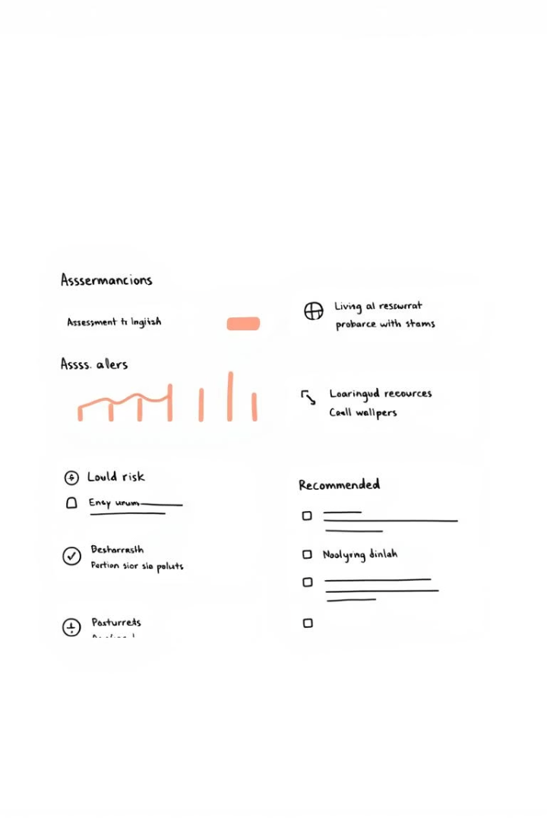




Applications: Empowering Support Systems
Professional Tools
Personalized Support
Crisis Detection
Assist psychologists and clinicians with early detection alerts generated from social media monitoring.
Deliver tailored resource recommendations and coping strategies based on individual online behavior.
Identify anomalies signaling potential mental health crises for timely intervention.
Public Health
Enable large-scale mental health trend monitoring and targeted awareness campaigns.

Slide 10

Conclusion: A Future of Early Detection and Awareness
Early Detection
Timely identification of mental health risks enables more effective interventions and better outcomes.
Raising Awareness
Leveraging data to reduce stigma and encourage open conversations about mental health challenges.
Ethics & Collaboration
Prioritizing ethical frameworks and partnerships between technologists, clinicians, and policymakers is critical.
Future Directions
Longitudinal research, personalized treatment models, and improved analytical accuracy will expand impact.
Let’s work together to build a supportive society that harnesses technology responsibly to improve mental health for all.

